Slide 1
CSE 11
Accelerated Intro to Programming Discussion Section 2
Summer Session 1 2021
This discussion is being recorded

Slide 2
Reminders
PA0.5 and PA1 due today!
If you need more help, tutor hours available today
Turn in on gradescope

Slide 3




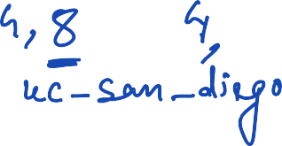









Lecture recap
String
Class
Methods
Example : String Place = “uc_san_diego”
Place.length()
Place.substring(4, 8)
Place.replace(“e”, “WE”)
Place.repeat(2)
Booleans
data type - true/false
Example :
boolean b1 = 4 < 5
boolean b1 = 4 == 5

Slide 4






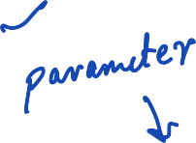






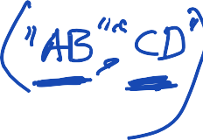















Constructors
class Author { String name; String fullName;
Author(String name, String fullName) { this.name = name;
this.fullName = fullName;
}
String toText() {
return this.fullName;
}
}

Slide 5

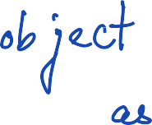













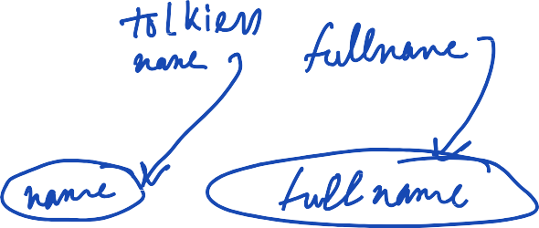





Constructors
class Book { String title; Author author; int price;
Book(String title, Author author, int price) { this.title = title;
this.author = author; this.price = price;
}
class ExampleBooks {
Author tolkien = new Author("JRR Tolkien", "John Ronald Reuel Tolkien");
Book theTwoTowers = new Book("The Two Towers", tolkien, 8);
}

Slide 6
PA 2
Just released, due next Wednesday at 11:59pm PST
https://github.com/CSE11-SP21-Assignments/cse11-sp21-pa2-starter

Slide 7
Thanks!

